Slide 1
Development of the insurance market in the context of digitalization
KAZAN (VOLGA REGION) FEDERAL UNIVERSITY
INSTITUTE OF MANAGEMENT, ECONOMICS AND FINANCE
PRESIDENT PROGRAM ON TRAINING MANAGERS AND EXECUTIVES
Written By : Ermolaeva Elena
Scientific adviser : Candidate of Economics, Associate Professor Karasik Elena Anatolyevna

Slide 2
General characteristics of the Kazan branch of CJSC "VSK" in the Republic of Tatarstan
At the end of 2021, the insurance market of the Republic of Tatarstan grew by 7.2% (excluding life insurance and CHI). The volume of the insurance market reached 24.644 billion rubles. Steady growth in collections, loss control, competent diversification of assets, customer confidence provide a driver for further development and increase in the share of the insurance market.
The strategic program is aimed at increasing fees, margins and increasing the efficiency of the Agent Channel.
The Kazan branch of CAO VSK was opened on April 8, 1993. The first branch was opened in the city of Kazan. In 1993, the number of employees was 7 people. In 2022, the Kazan branch turned 29 years old, the number of employees increased to 86 people.
According to the results of 12 months of 2021, the share of VSK IJSC in the Republic of Tatarstan is 7.2%, the volume of insurance premiums amounted to 1.732 billion rubles, it occupies the 5th position in terms of fees. At the end of 2021, the increase was 12.3%. Developed agency and partner network. According to the data of 2021, GPC agreements with more than 300 agents and partners have been concluded in the Kazan branch.
The company's insurance portfolio is one of the most balanced on the market, while meeting the general structure of fees in the Russian Federation, both in terms of individual types, and in terms of compulsory and voluntary insurance. The investment portfolio is diversified by terms, sectors, issuers and risk level.

Slide 3
Reasons for the need to implement the project
Альметьевск
Development of a classical agent network throughout the territory of the Republic of Tatarstan
High acquisition costs due to market brokers
High operating costs for consumables and forms of strict accountability
Improving the well-being of residents of the Republic of Tatarstan (clients and agents)
Difficulties in the logistics of receiving insurance documentation.
According to order 710-P of the Central Bank of the Russian Federation

Slide 4
Associated factors influencing the development of digitalization
The potential for the development of retail insurance in the Republic of Tatarstan, using digital technologies, is quite high.
The growing interest from consumers, the high level of penetration of digital technologies in all spheres of life, the restrictions during the pandemic, the growth in the income level of the population in the Republic of Tatarstan give impetus to the transformation of the current sales model in retail insurance.
потенциал развития розничного страхования в Республике Татарстан, с использованием цифровых тпотенциал развития розничного страхования в Республике Татарстан, с использованием цифровых технологий, достаточно высокий. ехнологий, достаточно высокий.

Slide 5
Objective of the project
- The key goal of the work is to propose a project that will be aimed at improving the financial performance of the Company through:
- development of the Company's regional network by creating new remote services and forming a network of representatives;
- Improving the efficiency of existing branches and additional offices by attracting employees of corporate clients.
The objectives of the project are the foundations for building distance sales methods and tools for the development of digitalization.
The paper gives a theoretical definition of digital insurance and shows its need.
Digital activity indicators have been developed and calculated, in particular, the calculation of savings in acquisition and operating costs.
The proposed tools are partially implemented in the work of the agency and office sales channels of the Kazan branch of CJSC VSK.
Key performance indicators to be achieved by December 30, 2022. This experience can be used and broadcast to the entire federal network of SAO VSK.

Slide 6
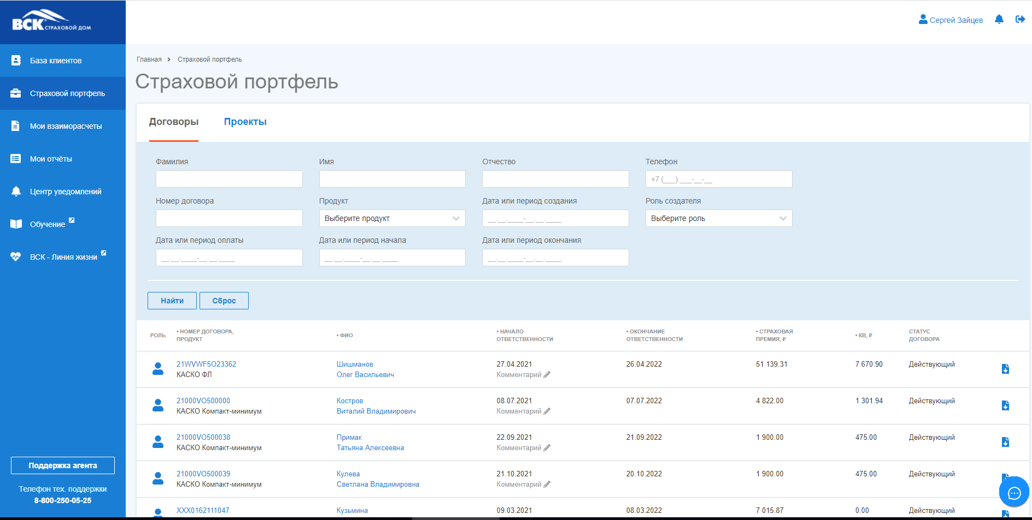
Project "Agent's Personal Account"
The functionality of the "personal account of the agent"
Registration with confirmation of the phone, followed by linking the client's personal account (LCC) to the agent and paying the agent a commission for policies purchased by the client on his own. (under CASCO and E-OSAGO policies)
Registration without phone confirmation of CASCO, KKM and E-OSAGO policies, without linking the LCC.
Prolongation of CASCO, KKM and e-OSAGO policies with pulling up the data of the previous policy from accounting systems.
Applying a discount when applying for a CASCO policy.
The use of SPPG during the prolongation of the CASCO policy.
Editing a client profile.
Registration of a CASCO policy for a client from any region.Функционал «личного кабинета агента»
Prolongation of CASCO, KKM and e-OSAGO policies with pulling up the data of the previous policy from accounting systems.
Applying a discount when applying for a CASCO policy.
The use of SPPG during the prolongation of the CASCO policy.

Slide 7
Progress in the implementation of the "Agent's Personal Account" project
PI 4 (21)
PI 1 (22)
PI 2 (22)
PI 3 (22)
PI 4 (22)
Новый ЛКА. ОСАГО, ДЗ, Расчетный лист, очередные платежи, взаиморасчеты
Работа с дебиторской задолженностью
Безбумажный сервис для Агентов
Бизнес-процессы
Операционный функционал для ЮЛ в ЛКА
Чат-Бот
Мобильное приложение ЛКА (операционный ф-л)
Динамическое КВ (ОСАГО, КАСКО, ИФЛ)
Программы мотивации под сегменты Агентов
Мотивация
Мотивация от Фин. результата
Нефинансовая мотивация Агента
Мотивация сотрудников (МОАП, РА)
Электронный Агентский договор
Цифровой Агент
Новый ЛКА: Кабинет Потенциального Агента
Рабочее место куратора: CRM , отчетность по агентской группе , работа с котировками Агента
Хантинг агентов (централизованный + инструменты для сети)
Агент-перезагрузка
Контекстное обучение в ЛКА
Адаптация/ реактивации сегментов агентов
Мобильная версия Web-Tutor

Slide 8
Куар код и схема запуска
Project "QR code of the enterprise". Project progress

Slide 9
The introduction of the "Agent's Personal Account" tool will save 2,655,479 rubles by the end of 2022, due to the transfer of registrations and mutual settlements to the online mode. Switching to online support saves 1.5% of acquisition costs. The calculations included an annual acquisition rate of 32.875%. The introduction of the QR code tool at enterprises will save 2,030,272 rubles by the end of 2022. Calculation - Conversion = 5,145 purchases / 102,903 total number of employees * 100% .5% (value taken as a basis for the internal study of CJSC "VSK"). Thus, by introducing digitalization tools, the company improves financial performance, increasing the loyalty of agents and customers. If you implement all the proposed options for transforming sales, you can save 2.65 million on operating costs and 2.03 on acquisition costs when registering through a non-acquisition sales channel. Annual savings amount to 4.65 million rubles.
The effect of the introduction of digitalization
да.

Slide 10
Risks and limitations in the development of the program
Риск | Вероятность | Степень воздействия | оцифровка риска | Пути решения
сбой интеграционных платформ | высокая | высокая | 1 000 000 рублей в день | Ежедневное тестирование программы. Отработка заявок на устранение ошибок группой технической поддержки. Использование российского программного обеспечения.
демпинг конкурентов | высокая | высокая | 250 000 рублей в день | Еженедельный мониторинг тарифов конкурентов. Коректировка тарифов с андеррайтерами.
платежеспособность клиентов, в условиях экономической ситуации | средняя | низкая | 100 000 рублей в день | Увеличить количество предприятий с QR кодом.
дефицит агентов | низкая | низкая | 100 000 рублей в день | Увеличение воронки хантинга. Сотрудничество с "Центром занятости населения " в РТ. Ввод программы наставничества.
увольнение сотрудников | низкая | низкая | 100 000 рублей в день | Составление Индивидуального плана развития. Увеличение продаж действующими агентами.
ошибки ввода | низкая | средняя | 50 000 рублей в день | Обучение агентов.

Slide 11
!
Digital transformation is a key component of the overall business transformation strategy. It is not the only success factor, but it largely determines the outcome of any transformation project. The chosen tools, combined with the competencies of people, processes and operations, allow organizations to quickly adapt to complex situations, seize promising opportunities, and meet new and changing customer needs.
Thank you for your attention!
The theme of the project is the development of the insurance market in the context of digitalization.
Project author: Ermolaeva Elena Yurievna
Project leader: Candidate of Economics, Associate Professor Karasik Elena Anatolyevna

